Slide 1
LECTURE 1
Knowledge, Representation
and Reasoning
Contents
Objectives
Knowledge and its types
Define knowledge, representation and reasoning.
Data, information and knowledge
Explain knowledge types and their link to intelligence.
Distinguish data, information and knowledge.
Knowledge representation
Explain why AI systems need representation.
Reasoning and its types
Apply a rule to derive a conclusion.
Knowledge-based systems and practice
Identify these components in an AI scenario.
AIC372 / BS Computer Science / 75 minutes
01
Notes:
Source: Lecture 1 — Knowledge, Representation and Reasoning.pdf, pages 1–3, 38–39. Supplied AIC372 handout. Reference named in the handout: Levesque, Chapter 1.
Instructor answer guide
CLO-1: Explain types of knowledge and their relation to intelligence. Official Bloom level: Understanding; student outcome: SO1. Practice also addresses Apply and Analyze.
The title slide retains the lecture number, contents, and all six objectives.
The handout’s opening questions, worked-example prompts, classroom discussion, Bloom questions, formative questions, CLO task, homework, and exit ticket appear as student-facing prompts. Expected responses accompany the assessment slides in these notes. Use questions throughout instruction and allow an attempt before showing worked solutions.

Slide 2
Opening Questions: Knowledge and Intelligence
1
What makes a computer system intelligent?
2
Does storing a large amount of information automatically make a computer intelligent?
3
What do we mean by knowledge?
02
Notes:
Source: Lecture 1 — Knowledge, Representation and Reasoning.pdf, pages 4–5. Supplied AIC372 handout. Reference named in the handout: Levesque, Chapter 1.
Instructor answer guide
1. Examples include problem solving, planning, learning, prediction, and answering questions. Students should explain the useful behavior.
2. No. Storing information alone does not ensure that the system can represent or use it effectively.
3. In AI, knowledge concerns domain facts, concepts, relationships, rules, and principles that support answers, solutions, and decisions.

Slide 3
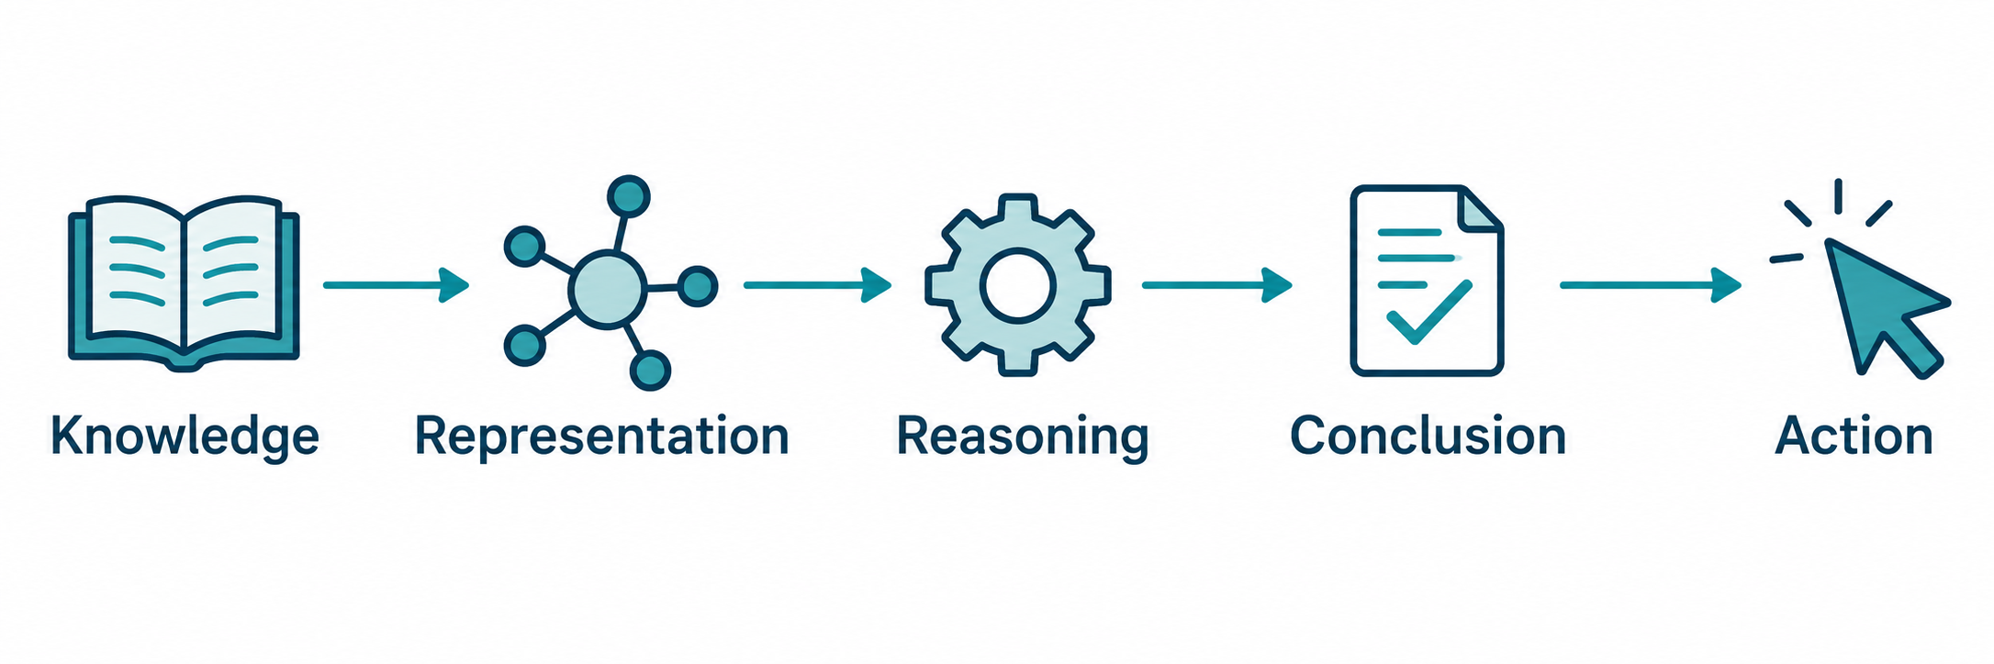
Intelligent Behavior in AI
An AI system uses what it knows to answer questions, solve problems, or choose actions.
What does it know?
How is that knowledge expressed?
What follows from it?
03
Notes:
Source: Lecture 1 — Knowledge, Representation and Reasoning.pdf, pages 4–5, 23–24. Supplied lecture notes for AIC372. Reference given by the source: Levesque, Chapter 1.
Opening discussion: What makes a computer system intelligent? Invite examples such as learning, planning, prediction, question answering, and problem solving. Ask whether a large store of facts alone is sufficient. Emphasize that this lecture studies the contribution of represented knowledge and reasoning to intelligence, rather than a complete definition of intelligence.

Slide 4
Knowledge in AI
Knowledge is information about a domain that a system can use to answer questions, solve problems, or make decisions.
Fact
Rule
Ali is a student.
Every student has an ID.
Student(Ali)
Student(x) → HasID(x)
Knowledge can also describe relationships, categories, properties, and constraints.
04
Notes:
Source: Lecture 1 — Knowledge, Representation and Reasoning.pdf, pages 5–7. Supplied lecture notes for AIC372. Reference given by the source: Levesque, Chapter 1.
Knowledge includes facts, concepts, properties, relationships, rules, constraints, general principles, and assumptions. A fact describes a particular situation; a rule connects a condition to a conclusion. Present Student(x) → HasID(x) as a simplified universal rule in this example.

Slide 5
Types of Knowledge
Type | Meaning | Example
Factual | Facts or situations | Ali is a student.
Conceptual | Concepts and categories | A student is a type of person.
Relational | Connections between entities | Studies(Ali, ComputerScience)
Rule-based | Conditions and conclusions | Passing all required courses permits graduation.
Each type helps the system describe or reason about its domain.
05
Notes:
Source: Lecture 1 — Knowledge, Representation and Reasoning.pdf, pages 7–8. Supplied lecture notes for AIC372. Reference given by the source: Levesque, Chapter 1.
CLO-1 focus. Ask students to classify examples and explain the reason for their choice. These introductory categories can overlap. Factual: Islamabad is the capital of Pakistan. Conceptual: a car is a vehicle. Relational: LocatedIn(Lahore, Pakistan). Rule-based: a student who passes all required courses can graduate, under the simplified rule given in the source.

Slide 6
Data, Information and Knowledge
Concept | Meaning | Example
Data | Raw values or observations | 25
Information | Data with meaningful context | Ali is 25 years old.
Knowledge | Facts and rules used to understand or infer | Given the rule “age > 18 means adult,” infer that Ali is an adult.
Context gives data meaning. Applying a rule supports a conclusion.
06
Notes:
Source: Lecture 1 — Knowledge, Representation and Reasoning.pdf, pages 9–10. Supplied lecture notes for AIC372. Reference given by the source: Levesque, Chapter 1.
The source uses 25 without context, Ali is 25 years old, and an age rule to distinguish the concepts. Treat the adulthood example only as the stated classroom rule, not as legal advice or a universal legal definition. Alternative information example: the temperature is 25°C. Ask students to supply another example at each level.

Slide 7
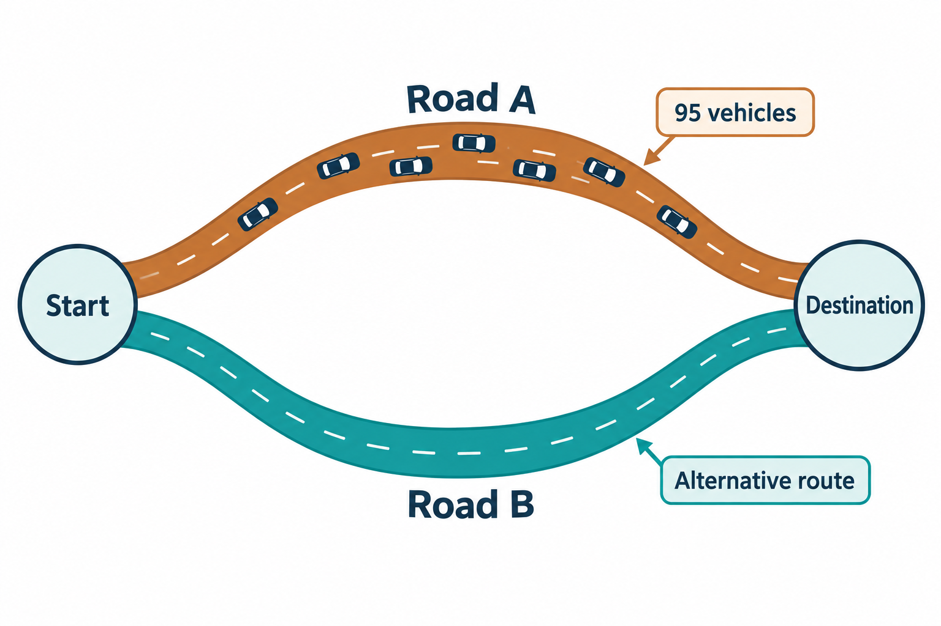
Traffic Data and Route Decisions
Data
A sensor counts 95 vehicles.
Information
Road A has heavy traffic.
Knowledge
Heavy traffic increases travel time.
Reasoning
Road B may offer a faster route.
Decision
Recommend Road B if evidence supports it.
Classroom example. Vehicle icons are symbolic.
07
Notes:
Source: Lecture 1 — Knowledge, Representation and Reasoning.pdf, pages 10–11, 17. Supplied lecture notes for AIC372. Reference given by the source: Levesque, Chapter 1.
This is an illustrative scenario. A count of 95 vehicles alone does not establish congestion without road capacity, time window, speed, or another contextual rule. Similarly, a faster alternate route needs supporting information. Preserve the source’s tentative conclusion: Road B may be faster. Ask where domain knowledge enters the process and which observations would support the recommendation.

Slide 8
Traffic System: Knowledge in Use
A sensor reports 95 vehicles on Road A. The system interprets heavy traffic, uses a travel-time rule, and recommends an alternative route.
Discussion
At which stage does the system begin to use knowledge?
Explain your choice using the traffic example.
08
Notes:
Source: Lecture 1 — Knowledge, Representation and Reasoning.pdf, pages 10–11. Supplied AIC372 handout. Reference named in the handout: Levesque, Chapter 1.
Instructor answer guide
The knowledge stage supplies the rule linking heavy traffic and travel time; reasoning uses it with the information to compare routes. A strong response distinguishes holding the rule from applying it. The road count and heavy-traffic interpretation are the handout’s classroom example, not a real traffic threshold.

Slide 9
Knowledge Representation
Knowledge representation expresses knowledge in a structured or formal form that a computer can use for reasoning.
Natural language
All students who pass the examination receive a certificate.
Formal rule
Passes(x) → ReceivesCertificate(x)
Specific fact
Passes(Ali)
x stands for an object. The arrow means “if ... then ...”.
09
Notes:
Source: Lecture 1 — Knowledge, Representation and Reasoning.pdf, pages 11–13. Supplied lecture notes for AIC372. Reference given by the source: Levesque, Chapter 1.
Explain that a formal or structured representation gives a system something it can process. In these introductory rules, x stands for any relevant object; → means “if ... then ...”. Full first-order logic syntax and quantifiers will come later. Connect Passes(Ali) with the rule to preview ReceivesCertificate(Ali).

Slide 10
Components of a Representation
Component | Role | Example
Entities | Things in the domain | Ali, Sara, Car1
Properties | Characteristics of entities | Red(Car1)
Relations | Connections between entities | Studies(Ali, ComputerScience)
Rules | Conditions for conclusions | Student(x) → HasID(x)
Categories | Membership and generalization | Student(x) → Person(x)
10
Notes:
Source: Lecture 1 — Knowledge, Representation and Reasoning.pdf, pages 12–14. Supplied lecture notes for AIC372. Reference given by the source: Levesque, Chapter 1.
Translate “Ahmed is a student and studies Computer Science” into Student(Ahmed) and Studies(Ahmed, ComputerScience). To infer that Ahmed is a person, the system also needs a category rule such as Student(x) → Person(x). Distinguish individual entities such as Ali and Car1 from categories such as Student and Vehicle.

Slide 11
Logic and Production Rules
Logic
Production rules
Represents facts and relationships using logical statements.
Expresses what to do when a condition holds.
Human(x) → Mortal(x)
IF temperature > 30°C
THEN turn on cooling
If something is human, it is mortal.
Both approaches make a condition and its consequence explicit.
11
Notes:
Source: Lecture 1 — Knowledge, Representation and Reasoning.pdf, pages 14–15. Supplied lecture notes for AIC372. Reference given by the source: Levesque, Chapter 1.
Introduce these approaches without a detailed syntax lesson. Logic states facts and implications. Production rules connect conditions to actions. The cooling rule is the classroom example from the source, with the temperature threshold shown as 30°C for clarity.

Slide 12
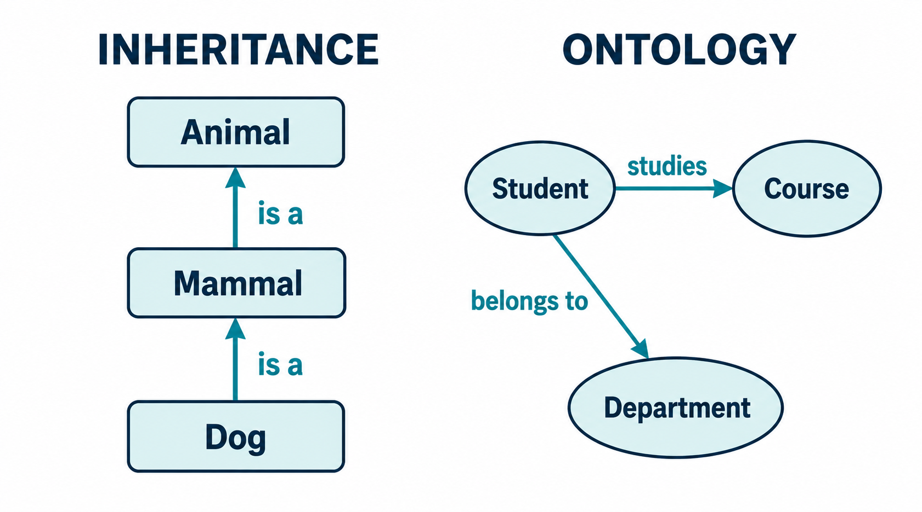
Frames, Inheritance and Ontologies
FRAME
Student
Name
Age
Department
Courses
RegistrationNo
Attributes of an object
Category relationships
Domain concepts
and their relationships
12
Notes:
Source: Lecture 1 — Knowledge, Representation and Reasoning.pdf, pages 15. Supplied lecture notes for AIC372. Reference given by the source: Levesque, Chapter 1.
These are a preview of approaches developed later in the course. A Student frame has attributes Name, Age, Department, Courses, RegistrationNo. Inheritance organizes categories: Dog is a Mammal, Mammal is an Animal. An ontology describes domain concepts and their relationships. Avoid suggesting that every property always inherits without exceptions.

Slide 13
Representation: Storage and Questions
1
Why can’t we simply store everything as raw data?
2 Given this knowledge
Studies(Ali, ComputerScience)
What does Ali study?
13
Notes:
Source: Lecture 1 — Knowledge, Representation and Reasoning.pdf, pages 16–17. Supplied AIC372 handout. Reference named in the handout: Levesque, Chapter 1.
Instructor answer guide
1. Raw data alone does not explicitly organize entities, relationships, and rules for reasoning. A structured representation supports organization, inference, question answering, problem solving, and decisions.
2. Ali studies Computer Science; Studies(Ali, ComputerScience) directly represents that relationship.

Slide 14
Why Representation Matters
Organization
Connect facts about students, courses, and universities.
Reasoning
Use a student fact and an ID rule to derive a new conclusion.
Question answering
Use Studies(Ali, ComputerScience) to answer what Ali studies.
Problem solving
Use domain relationships to investigate possible causes.
Decision making
Use conditions and rules to recommend an action.
14
Notes:
Source: Lecture 1 — Knowledge, Representation and Reasoning.pdf, pages 16–17. Supplied lecture notes for AIC372. Reference given by the source: Levesque, Chapter 1.
Cover all five source purposes: organization, reasoning, question answering, problem solving, and decision making. Example query: from Studies(Ali, ComputerScience), answer “What does Ali study?” Diagnostic systems may use symptoms and relationships to reason about possible conditions; no clinical conclusion is required here.

Slide 15
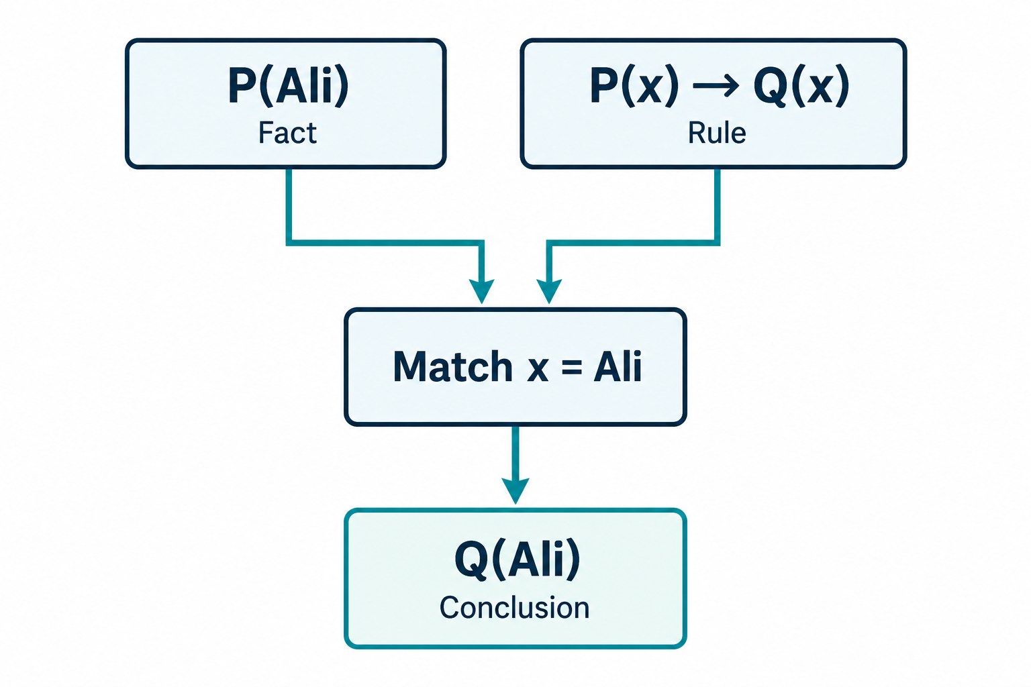
Reasoning with Known Facts
Reasoning
Uses available knowledge to determine what follows.
Rule application
Match the fact to the condition, then substitute Ali for x.
The matching fact and the rule support the conclusion.
15
Notes:
Source: Lecture 1 — Knowledge, Representation and Reasoning.pdf, pages 18–19, 38–39. Supplied lecture notes for AIC372. Reference given by the source: Levesque, Chapter 1.
Reasoning uses available knowledge to determine what follows. Introduce the rule-application pattern often called modus ponens. Emphasize that the fact must match the condition. The conclusion follows within the represented model when the premises hold and the inference is valid.

Slide 16
Deductive Practice: Two Conclusions
Case 1: Socrates
Case 2: Ahmed
Human(x) → Mortal(x)
Human(Socrates)
CSStudent(x)
→ StudiesProgramming(x)
CSStudent(Ahmed)
What can we conclude?
What can we conclude?
For each case, identify the rule and the matching fact.
16
Notes:
Source: Lecture 1 — Knowledge, Representation and Reasoning.pdf, pages 18, 28. Supplied AIC372 handout. Reference named in the handout: Levesque, Chapter 1.
Instructor answer guide
Case 1: Human(Socrates) matches Human(x), with x = Socrates; derive Mortal(Socrates).
Case 2: CSStudent(Ahmed) matches CSStudent(x), with x = Ahmed; derive StudiesProgramming(Ahmed). Ask for the matching fact, rule, substitution, and conclusion. The following worked examples can support feedback.

Slide 17
Deduction and Derived Knowledge
Deduction applies a general rule to a specific fact.
Explicit knowledge
Derived knowledge
The system receives the rule and fact.
The system infers the conclusion.
Human(x) → Mortal(x)
Human(Socrates)
Mortal(Socrates)
Socrates is mortal.
A valid deductive step preserves truth when the premises are true.
17
Notes:
Source: Lecture 1 — Knowledge, Representation and Reasoning.pdf, pages 18–21. Supplied lecture notes for AIC372. Reference given by the source: Levesque, Chapter 1.
Ask for the conclusion before revealing or discussing the lower-right result. Deductive inference guarantees the conclusion only if its premises are true and the inference is valid. Both Human(Socrates) and the rule are explicit knowledge. Mortal(Socrates) is derived knowledge, even if the system later stores it.

Slide 18
Worked Example: Ahmed Studies Programming
1 Identify the rule
CSStudent(x) → StudiesProgramming(x)
2 Find the matching fact
CSStudent(Ahmed)
3 Substitute the individual
x = Ahmed
4 Derive the conclusion
StudiesProgramming(Ahmed)
Ahmed studies programming.
18
Notes:
Source: Lecture 1 — Knowledge, Representation and Reasoning.pdf, pages 28–29. Supplied lecture notes for AIC372. Reference given by the source: Levesque, Chapter 1.
Bloom level: Apply. Read the two knowledge statements: Every CS student studies programming; Ahmed is a CS student. Ask students to identify the variable substitution and justify why the rule matches. This is a new instance of the same inference pattern.

Slide 19
Practice: Reasoning Through Categories
Given these relationships:
Dog(x) → Animal(x)
Animal(x) → LivingThing(x)
LivingThing(x) → RequiresEnergy(x)
Does a dog require energy?
Show the reasoning chain that supports your answer.
19
Notes:
Source: Lecture 1 — Knowledge, Representation and Reasoning.pdf, pages 22. Supplied AIC372 handout. Reference named in the handout: Levesque, Chapter 1.
Instructor answer guide
Yes. Dog(x) implies Animal(x), Animal(x) implies LivingThing(x), and LivingThing(x) implies RequiresEnergy(x). Chain the rules to derive Dog(x) → RequiresEnergy(x). These predicates formalize the handout’s category arrows.

Slide 20
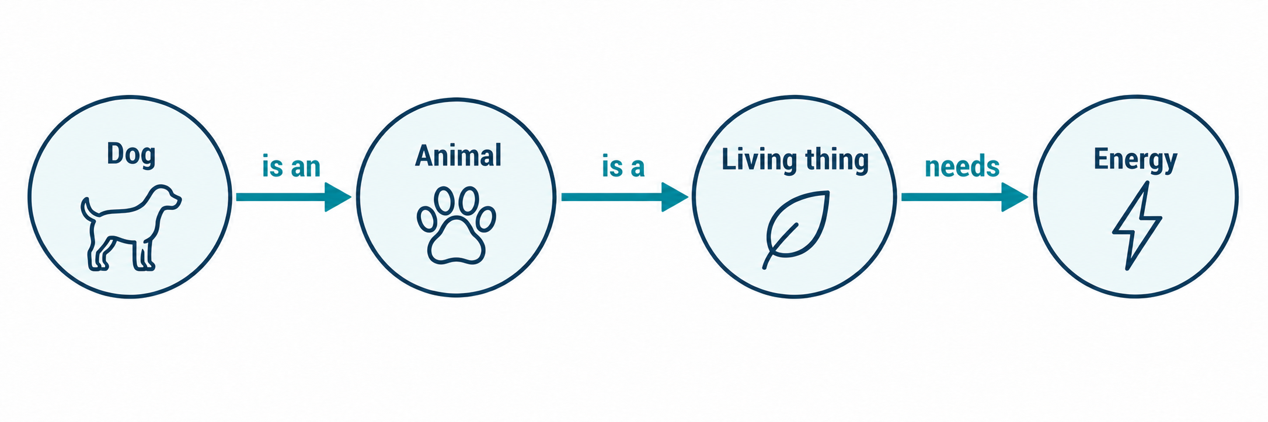
Reasoning Across Several Rules
Dog(x) → Animal(x)
Animal(x) → LivingThing(x)
LivingThing(x) → RequiresEnergy(x)
Derived rule
Dog(x) →
RequiresEnergy(x)
A conclusion from one rule can support the next reasoning step.
20
Notes:
Source: Lecture 1 — Knowledge, Representation and Reasoning.pdf, pages 22. Supplied lecture notes for AIC372. Reference given by the source: Levesque, Chapter 1.
The source uses conceptual category arrows. Here the same relations appear as predicates to keep the rule syntax consistent. The conclusion that every dog requires energy follows by applying the three rules in sequence. A system that merely stores them may not have derived this result.

Slide 21
Inductive Reasoning
Induction uses observations to support a generalization.
Observation
All four observed crows are black.
Generalization
Crows are generally black.
Four observations do not prove that every crow is black.
21
Notes:
Source: Lecture 1 — Knowledge, Representation and Reasoning.pdf, pages 20–21. Supplied lecture notes for AIC372. Reference given by the source: Levesque, Chapter 1.
Induction generalizes from observations. The crow example supports a generalization but cannot prove that every crow is black. Additional observations can strengthen, weaken, or challenge the generalization. This lecture introduces the idea rather than statistical estimation.

Slide 22
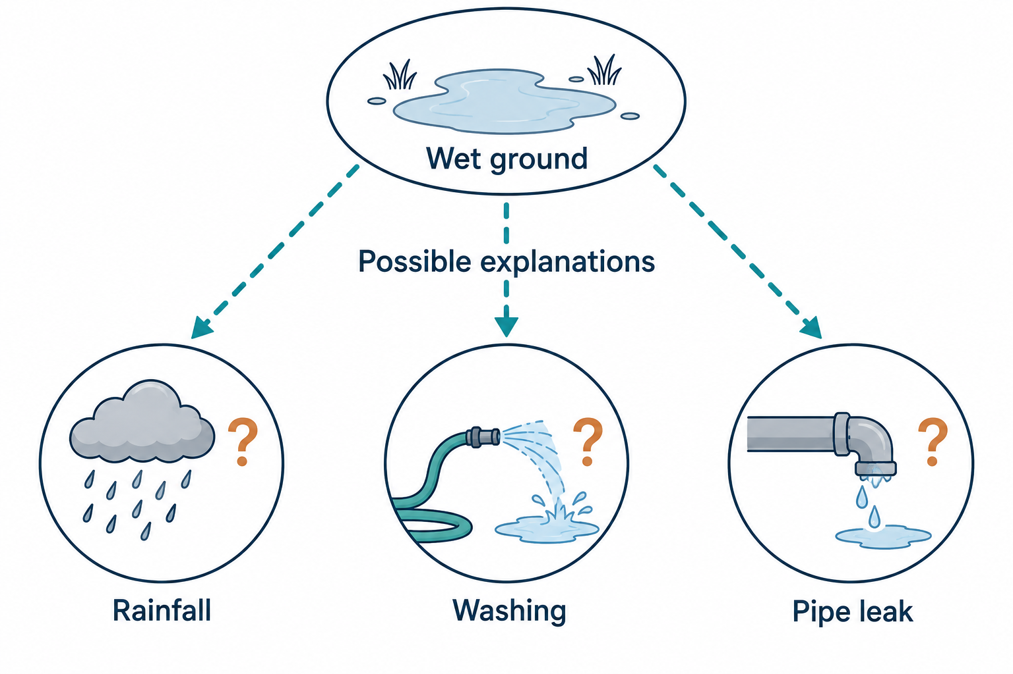
Abductive Reasoning
Abduction seeks a plausible explanation for an observation.
A weather report indicating rain can support the rainfall explanation.
22
Notes:
Source: Lecture 1 — Knowledge, Representation and Reasoning.pdf, pages 21. Supplied lecture notes for AIC372. Reference given by the source: Levesque, Chapter 1.
Abduction proposes explanations for observations. It does not establish that an explanation must be true. Ask which evidence would distinguish rainfall, washing, and a leak. Weather information indicating rain can make rainfall a stronger explanation.

Slide 23
Comparison of Reasoning Types
Type | Reasoning pattern | Main question | Status of conclusion
Deductive | Rule and fact to conclusion | What must follow? | Entailed if the premises hold and inference is valid
Inductive | Observations to generalization | What generalization is supported? | Supported, but not guaranteed
Abductive | Observation to explanation | What could explain this? | Plausible, but not guaranteed
The reasoning method determines what kind of claim the conclusion supports.
23
Notes:
Source: Lecture 1 — Knowledge, Representation and Reasoning.pdf, pages 20–22. Supplied lecture notes for AIC372. Reference given by the source: Levesque, Chapter 1.
Use the table to distinguish purpose and certainty. Formal logical reasoning is particularly important in the course. Later topics named in the source include first-order logic, resolution, Horn clauses, SLD resolution, default reasoning, probability, Bayesian reasoning, and planning. These are previews rather than extra topics for this introductory lecture.

Slide 24
Discussion: Reasoning Without Knowledge
Suppose a system has a powerful reasoning mechanism but no domain knowledge.
Can it provide useful medical advice?
Justify your answer by identifying what the system is missing.
24
Notes:
Source: Lecture 1 — Knowledge, Representation and Reasoning.pdf, pages 23. Supplied AIC372 handout. Reference named in the handout: Levesque, Chapter 1.
Instructor answer guide
No, not from a reasoning mechanism alone. The system also needs domain knowledge such as symptoms, conditions, treatments, relationships, and rules. This is a conceptual AI question about missing domain knowledge, not a medical-advice exercise.

Slide 25
Knowledge and Reasoning Work Together
Knowledge without reasoning
Stored rules may leave useful conclusions undiscovered.
Reasoning without domain knowledge
A mechanism lacks the facts and rules needed for a useful answer.
Their combined role
Represent relevant knowledge, derive a conclusion, and choose an action.
25
Notes:
Source: Lecture 1 — Knowledge, Representation and Reasoning.pdf, pages 22–24. Supplied lecture notes for AIC372. Reference given by the source: Levesque, Chapter 1.
Explain both limitations in the source. Knowledge alone does not ensure that a system derives useful consequences. A reasoning mechanism still needs domain facts and rules. The combination contributes to intelligent behavior, with representation providing the usable form. A diagnostic mechanism without domain knowledge is the source example, but no medical advice is being taught.

Slide 26
Advising Practice: Course Registration
Student(Ali)
Completed(Ali, ProgrammingFundamentals)
Requires(DataStructures, ProgrammingFundamentals)
Rule
If a student has completed all prerequisites, the student can register for the course.
Can Ali register for Data Structures?
Assume this is the only prerequisite and no other restriction applies.
26
Notes:
Source: Lecture 1 — Knowledge, Representation and Reasoning.pdf, pages 24–25. Supplied AIC372 handout. Reference named in the handout: Levesque, Chapter 1.
Instructor answer guide
Yes under the example’s stated assumptions: Ali is a student and has completed Programming Fundamentals, the only prerequisite for Data Structures here. The all-prerequisites rule permits registration if no other restrictions apply. In an actual system, completion of one prerequisite alone would not establish full eligibility.

Slide 27
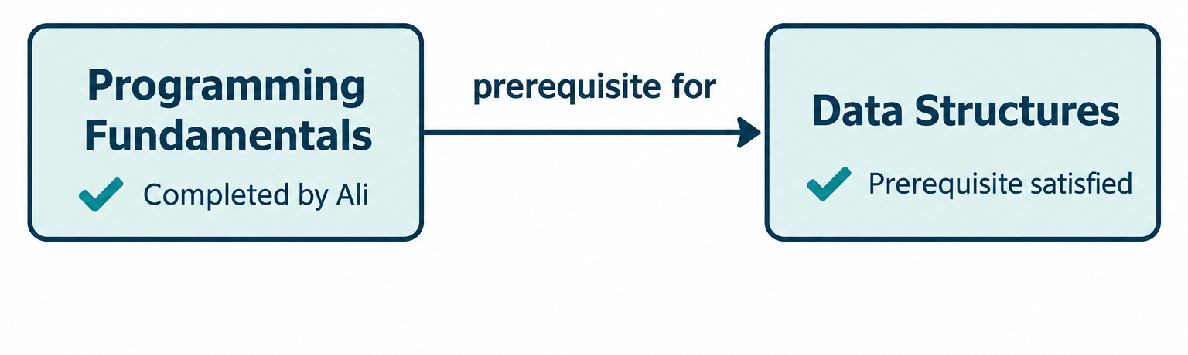
University Advising Example
Ali has completed the prerequisite for Data Structures.
Student(Ali)
Completed(Ali, ProgrammingFundamentals)
Requires(DataStructures, ProgrammingFundamentals)
Recommendation: Ali can register under the example’s rule.
Assume this is the only prerequisite and no other registration restriction applies.
27
Notes:
Source: Lecture 1 — Knowledge, Representation and Reasoning.pdf, pages 24–26. Supplied lecture notes for AIC372. Reference given by the source: Levesque, Chapter 1.
Use a simplified advising model. Assume Programming Fundamentals is the only prerequisite for Data Structures in this example and no other registration restriction applies. The source rule concerns completion of ALL prerequisites. In a real system, satisfying one prerequisite alone would not prove full eligibility. Ask students to identify knowledge, representation, reasoning, and resulting recommendation.

Slide 28
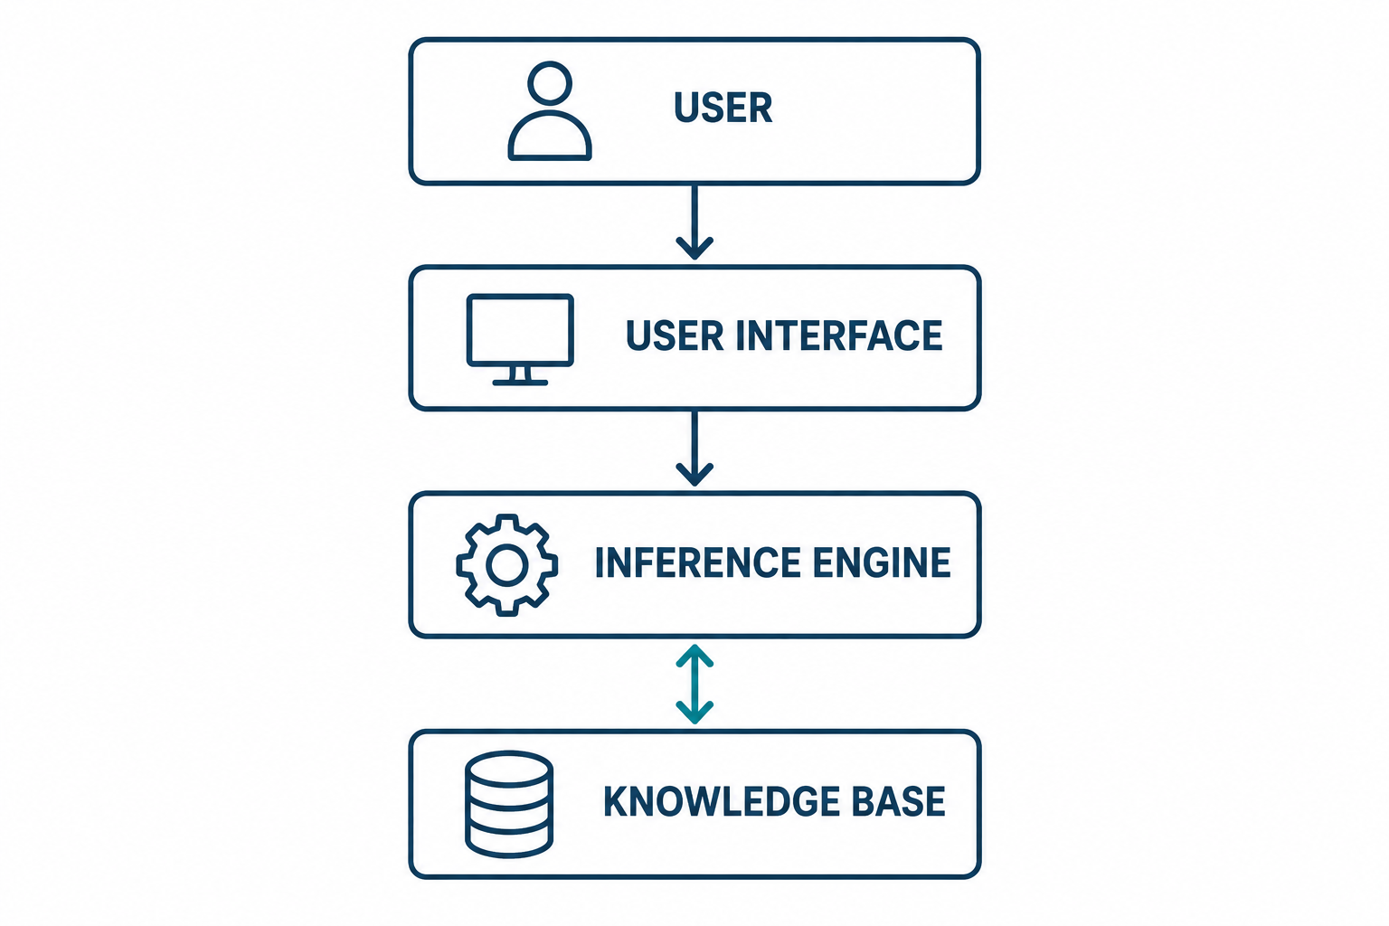
Knowledge-Based System Architecture
Knowledge base
Stores represented facts, rules, and relationships.
Inference engine
Applies reasoning to derive conclusions.
User interface
Receives questions and presents answers.
28
Notes:
Source: Lecture 1 — Knowledge, Representation and Reasoning.pdf, pages 24–26. Supplied lecture notes for AIC372. Reference given by the source: Levesque, Chapter 1.
A knowledge-based system combines a knowledge base and an inference mechanism to answer questions or solve problems. Walk through user question, interface, inference engine, and knowledge base. The engine works with represented facts, rules, relationships, concepts, and constraints. The simplified architecture follows the source figure.

Slide 29
Troubleshooting with a Knowledge Base
Known fact
BatteryLow(Car1)
Rules
BatteryLow(x) → EngineMayNotStart(x)
EngineMayNotStart(x) → CheckBattery(x)
Derived conclusions
EngineMayNotStart(Car1)
CheckBattery(Car1)
29
Notes:
Source: Lecture 1 — Knowledge, Representation and Reasoning.pdf, pages 26. Supplied lecture notes for AIC372. Reference given by the source: Levesque, Chapter 1.
The source’s simplified car troubleshooting example chains two rules. The predicate EngineMayNotStart expresses a possibility, not a certain mechanical diagnosis. Ask why the second rule recommends a check rather than asserting a confirmed fault.

Slide 30
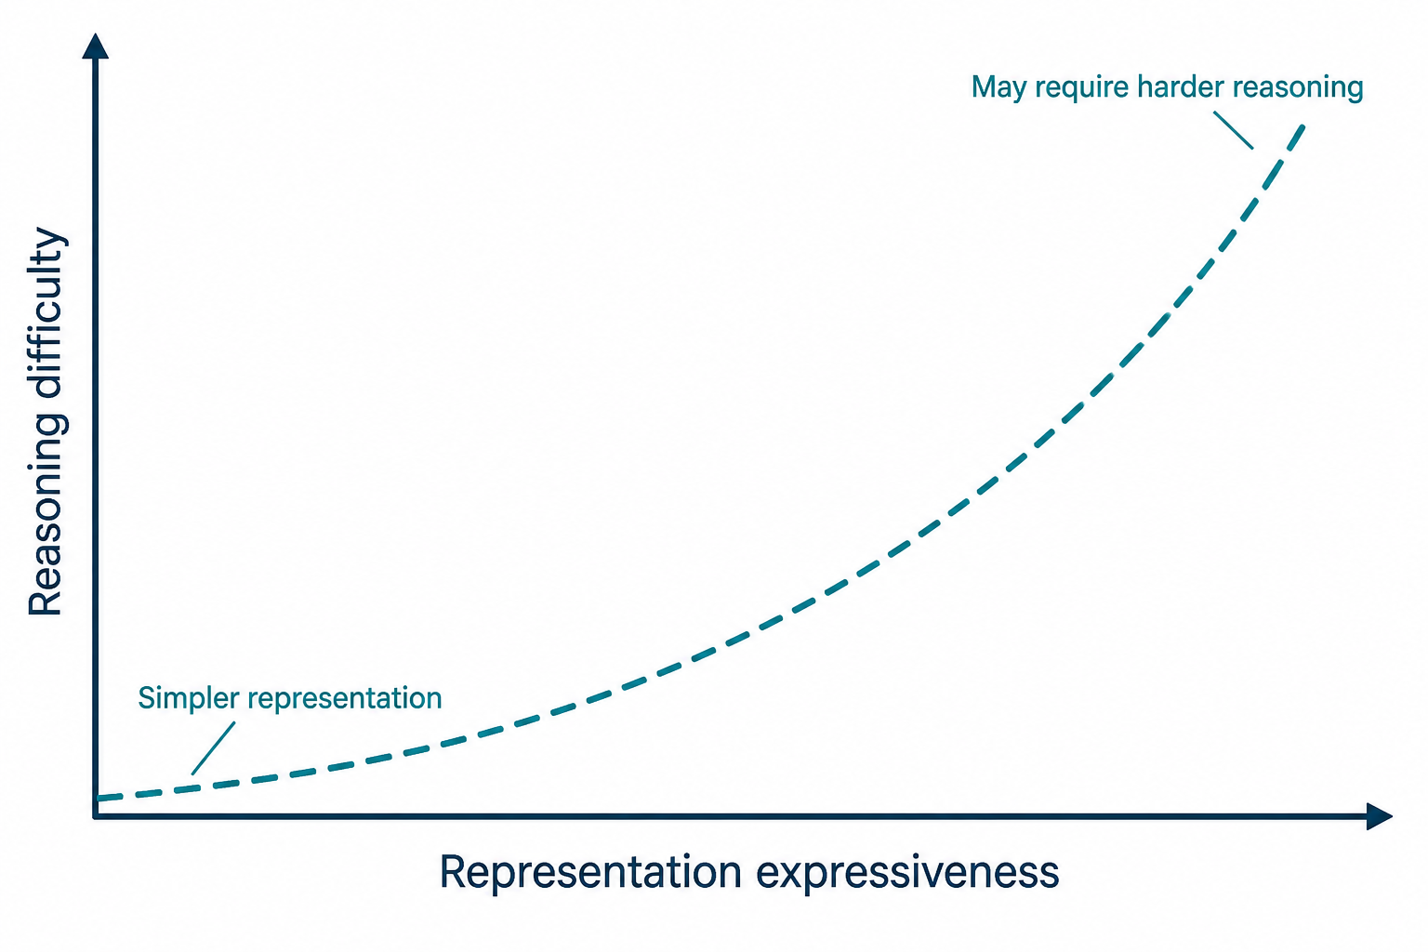
Expressiveness and Reasoning Difficulty
Greater expressiveness
Can describe more complex situations, exceptions, and uncertainty.
Simpler representations
Can make reasoning easier, while leaving some details unexpressed.
Conceptual illustration. Difficulty depends on the representation and reasoning task.
30
Notes:
Source: Lecture 1 — Knowledge, Representation and Reasoning.pdf, pages 26–27. Supplied lecture notes for AIC372. Reference given by the source: Levesque, Chapter 1.
Real domains contain objects, properties, relationships, events, categories, exceptions, incomplete information, and uncertainty. The tradeoff is conceptual: greater expressiveness can make reasoning harder, but the difficulty depends on the chosen language and inference task. Do not claim a strict universal complexity rule.

Slide 31
Classroom Activity: Exam-Hall Entry
Facts
Registered(Sara) ValidID(Sara)
Rules
Registered(x) → HasUniversityID(x)
HasUniversityID(x) ∧ ValidID(x)
→ CanEnterExamHall(x)
∧ means AND: both conditions must hold.
What can the system conclude about Sara?
Which conclusions require more than one condition?
31
Notes:
Source: Lecture 1 — Knowledge, Representation and Reasoning.pdf, pages 29–30. Supplied lecture notes for AIC372. Reference given by the source: Levesque, Chapter 1.
Allow about six minutes across this activity and the solution. Students first work individually or in pairs. Ask for given statements, derived statements, rules used, and the effect of an unmet validity condition. Bloom levels: Identify/Remember, Explain/Understand, Apply rules/Apply, and inspect missing conditions/Analyze. Do not show the next slide until students have attempted the chain.

Slide 32
Exam-Hall Activity: Discussion Questions
1
Which statements were given directly?
2
Which statement was inferred?
3
Which rule was used?
4
What would happen if Sara’s ID were not valid?
32
Notes:
Source: Lecture 1 — Knowledge, Representation and Reasoning.pdf, pages 29–30. Supplied AIC372 handout. Reference named in the handout: Levesque, Chapter 1.
Instructor answer guide
1. The two facts Registered(Sara) and ValidID(Sara), together with both rules, were given directly.
2. Infer HasUniversityID(Sara), then CanEnterExamHall(Sara).
3. First use Registered(x) → HasUniversityID(x), then the rule requiring both HasUniversityID(x) and ValidID(x).
4. If validity is not established or the ID is invalid, the entry rule cannot establish permission. Missing information alone is not proof of negation; a separate denial rule is needed to derive a formal denial.

Slide 33
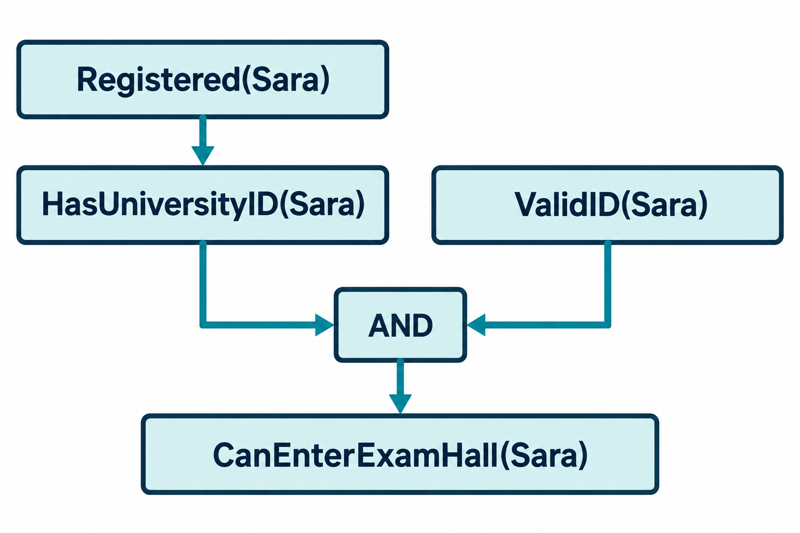
Exam-Hall Entry: Reasoning and Conditions
Two conditions
Sara must have a university ID, and that ID must be valid.
Unmet condition
This rule cannot establish permission if validity is unmet.
A derived fact can combine with an explicit fact in the next rule.
33
Notes:
Source: Lecture 1 — Knowledge, Representation and Reasoning.pdf, pages 29–30. Supplied lecture notes for AIC372. Reference given by the source: Levesque, Chapter 1.
Expected answer: Registered(Sara) with the first rule gives HasUniversityID(Sara). Combine it with ValidID(Sara) to use the second rule and derive CanEnterExamHall(Sara). If ValidID(Sara) is absent or fails, the entry rule cannot establish permission. Absence of a fact is not automatically proof of its negation. A separate denial rule would be needed to derive a formal “cannot enter” conclusion.

Slide 34
Common Misconceptions
Misconception | Clarification
Representation is just storing data. | Structure lets a system use and reason with knowledge.
Reasoning means calculation. | Reasoning also draws conclusions and explanations.
AI is only machine learning. | AI also includes representation and reasoning.
Every conclusion is certain. | Certainty depends on the premises and inference method.
Facts and conclusions have the same origin. | The system receives explicit facts and infers conclusions.
34
Notes:
Source: Lecture 1 — Knowledge, Representation and Reasoning.pdf, pages 31–32. Supplied lecture notes for AIC372. Reference given by the source: Levesque, Chapter 1.
Use selected rows as a quick check, inviting students to explain the correction. The distinctions are: structured knowledge versus raw storage; inference versus arithmetic alone; AI broader than machine learning; entailment versus uncertain conclusions; explicit versus derived knowledge.

Slide 35
Bloom Questions: Concepts and Rule Application
Remember
What is knowledge representation?
Understand
Explain why knowledge representation is important for AI.
Apply
Student(Ali)
Student(x) → HasID(x)
Derive the conclusion.
35
Notes:
Source: Lecture 1 — Knowledge, Representation and Reasoning.pdf, pages 31. Supplied AIC372 handout. Reference named in the handout: Levesque, Chapter 1.
Instructor answer guide
Remember: Knowledge representation expresses knowledge in a structured or formal form that supports computer reasoning.
Understand: It organizes usable knowledge and enables conclusions, answers, problem solving, and decisions.
Apply: Student(Ali) and Student(x) → HasID(x) give HasID(Ali). The rule matches x = Ali.

Slide 36
Bloom Questions: Analysis and Evaluation
Analyze
Consider an AI traffic system. Identify which parts represent data, knowledge, reasoning, and decision-making.
Evaluate
Why might simply storing more data not necessarily make an AI system more intelligent? Justify your answer.
How should knowledge be represented so that useful reasoning is possible?
36
Notes:
Source: Lecture 1 — Knowledge, Representation and Reasoning.pdf, pages 27, 31. Supplied AIC372 handout. Reference named in the handout: Levesque, Chapter 1.
Instructor answer guide
Analyze: In the traffic example, the count is data; the traffic/travel-time relationship is knowledge; comparing the alternative uses reasoning; recommending Road B is the decision. Context turns the count into information.
Evaluate: More stored data is insufficient without relevant knowledge, usable representation, and a reasoning mechanism. Students should justify their answer, not only say no.
Design question: Choose a structured representation that expresses the needed facts, relationships, and rules while supporting the intended reasoning. Discuss expressiveness and difficulty without asserting a universal numeric tradeoff.

Slide 37
Scenario Analysis: Academic Advising
A university AI advising system knows that Ahmed is a BSCS student, that Data Structures requires Programming Fundamentals, and that Ahmed has completed Programming Fundamentals. The system recommends that Ahmed register for Data Structures.
1 Identify the knowledge.
2 Identify how the knowledge can be represented.
3 Identify the reasoning performed.
4 Explain how the conclusion supports intelligent behavior.
Assume this is the only prerequisite and no other registration restriction applies.
37
Notes:
Source: Lecture 1 — Knowledge, Representation and Reasoning.pdf, pages 34. Supplied AIC372 handout. Reference named in the handout: Levesque, Chapter 1.
Instructor answer guide
CLO-1: Explain types of knowledge and their relation to intelligence.
1. Factual knowledge: Ahmed is a BSCS student and completed Programming Fundamentals. Relational knowledge: Data Structures requires Programming Fundamentals. Rule-based knowledge: completion of all prerequisites supports registration.
2. BSCSStudent(Ahmed), Completed(Ahmed, ProgrammingFundamentals), Requires(DataStructures, ProgrammingFundamentals), and an all-prerequisites rule.
3. The system checks the completed course against the required prerequisite.
4. The conclusion supports an appropriate course-registration recommendation under the simplifying assumptions.

Slide 38
Formative Check: Knowledge Concepts
Question 1
Define knowledge in the context of AI.
Question 2
Differentiate between data, information, and knowledge.
Question 3
Why is knowledge representation necessary?
38
Notes:
Source: Lecture 1 — Knowledge, Representation and Reasoning.pdf, pages 33. Supplied AIC372 handout. Reference named in the handout: Levesque, Chapter 1.
Instructor answer guide
Q1. Knowledge in AI is domain information about facts, concepts, relationships, rules, and principles that a system can use to answer questions, solve problems, or decide.
Q2. Data: raw observations; information: data in context; knowledge: usable facts or rules supporting interpretation and inference. Accept appropriate examples.
Q3. A structured or formal representation enables a computer to use knowledge for reasoning.

Slide 39
Formative Check: Inference and Reasoning Types
Question 4: Given
Human(x) → Mortal(x)
Human(Ali)
What can be concluded?
Question 5
Explain the difference between deductive, inductive, and abductive reasoning.
39
Notes:
Source: Lecture 1 — Knowledge, Representation and Reasoning.pdf, pages 33. Supplied AIC372 handout. Reference named in the handout: Levesque, Chapter 1.
Instructor answer guide
Q4. Derive Mortal(Ali) by substituting Ali for x in the rule.
Q5. Deduction derives a conclusion entailed by rules and facts. Induction supports a generalization from observations. Abduction proposes a plausible explanation for an observation. Inductive and abductive conclusions are not guaranteed.

Slide 40
Formative Check: Smart Traffic
Recall the classroom traffic example:
Sensors report 95 vehicles on Road A. The system interprets heavy traffic. It knows that heavy traffic generally increases travel time, considers Road B, and recommends an alternative route.
Question 6
Analyze a smart traffic system and identify where knowledge and reasoning are used.
40
Notes:
Source: Lecture 1 — Knowledge, Representation and Reasoning.pdf, pages 34. Supplied AIC372 handout. Reference named in the handout: Levesque, Chapter 1.
Instructor answer guide
Q6. Knowledge includes the relationship between heavy traffic and travel time. Reasoning combines the current traffic information and route knowledge to consider whether Road B is faster. The final route recommendation is a decision. The count is data and the interpreted traffic situation is information. Do not infer a universal heavy-traffic threshold from 95 vehicles.

Slide 41
Key Takeaways
Knowledge
What a system knows about its domain.
Representation
The structured form in which it expresses knowledge.
Reasoning
The process that derives conclusions from knowledge.
Intelligent behavior
Useful answers or actions supported by those conclusions.
Knowledge-based system
A knowledge base working with an inference mechanism.
41
Notes:
Source: Lecture 1 — Knowledge, Representation and Reasoning.pdf, pages 37–39. Supplied lecture notes for AIC372. Reference given by the source: Levesque, Chapter 1.
Closing recap. Ask students to explain the relation between knowledge types and intelligence, the core CLO-1 focus. Mention that later lectures examine knowledge-based systems and formal representations in greater detail.

Slide 42
Homework: Concepts and Comparison
Part A: Explain in your own words
Part B: Prepare a comparison table
Knowledge
Knowledge representation
Reasoning
Knowledge-based system
Compare data, information, and knowledge.
Include a definition and one example of each.
42
Notes:
Source: Lecture 1 — Knowledge, Representation and Reasoning.pdf, pages 35. Supplied lecture notes for AIC372. Reference given by the source: Levesque, Chapter 1.
Homework Parts A and B from the source. Ask for students’ own wording and examples. No due date or marks were supplied.

Slide 43
Homework: Reasoning About Tweety
Part C: Given
Bird(Tweety)
Bird(x) → Animal(x)
Animal(x) → LivingThing(x)
Determine what can be concluded about Tweety.
Show your reasoning step by step.
43
Notes:
Source: Lecture 1 — Knowledge, Representation and Reasoning.pdf, pages 35. Supplied AIC372 handout. Reference named in the handout: Levesque, Chapter 1.
Instructor answer guide
Part C: Bird(Tweety) and Bird(x) → Animal(x) imply Animal(Tweety). Apply Animal(x) → LivingThing(x) to infer LivingThing(Tweety). Students must show both steps and identify the rule used at each step.

Slide 44
Homework: Analysis of an AI Application
Part D: Select one AI application
Medical diagnosis, autonomous vehicle, university advising, smart traffic management, or robotics.
1 What knowledge does the system require?
2 How could that knowledge be represented?
3 What reasoning could the system perform?
4 What intelligent action could result?
44
Notes:
Source: Lecture 1 — Knowledge, Representation and Reasoning.pdf, pages 35–36. Supplied AIC372 handout. Reference named in the handout: Levesque, Chapter 1.
Instructor answer guide
Part D: Accept medical diagnosis, an autonomous vehicle, university advising, smart traffic management, or robotics. Look for relevant domain facts/rules, an explicit representation, a coherent inference, and an action supported by it. Assess conceptual understanding; do not require real-world clinical or operational instructions.

Slide 45
Exit Ticket
1 Complete the relationship
Knowledge + __________ supports intelligent behavior.
2 State the conclusion
Student(Ali) Student(x) → HasID(x)
3 Explain in one sentence
Why do we need knowledge representation?
45
Notes:
Source: Lecture 1 — Knowledge, Representation and Reasoning.pdf, pages 36–39. Supplied lecture notes for AIC372. Reference given by the source: Levesque, Chapter 1.
Answers: 1. Reasoning. 2. HasID(Ali). 3. Knowledge representation expresses knowledge in a structured or formal form so an AI system can use it for reasoning. Use the responses to check understanding and identify where the next lecture should begin.

